Slide 1
Unit-II

Slide 2
Difference between UX/UI Design
UX Design | UI Design
UX Design stands for User Experience Design. | Ul Design stands for User Interface Design.
UX design is focused on everything that affects the user’s journey to solve a problem. | UI design is a process that mainly focused on how the specific product’s surfaces look and function.
UX design deals with research, testing, development, content, and prototyping. | UI is a process of visually guiding the user through a product’s interface using interactive elements across all platforms.
UX design is developing and improving quality interaction between a user and all elements of a company. | UI design transmits the brand’s strength and visual assets to a product’s interface.
UX design is a complete experience which may not be limited to the screen. | UI design is usually visual design and information design around screens.
It involves creative and convergent thinking. | It involves creative and critical thinking.
UX design is based on the client’s needs and requirements. | UI design is based on the user’s needs and research.
UX design needs mockups, graphics, and layouts. | UI design needs wireframes, prototyping, and a good research approach.

Slide 3
Usability
Usability refers to how easy it is for users to interact with your product’s UI and complete a specific action. The core lies in the functional part, which should be smooth, error-free, easy to find, and user-friendly.
For example, if a user wants to sign up for a trial account, you can say that the signup flow has good usability when the process is error-free, not confusing and the user manages to complete the goal in one go.

Slide 4
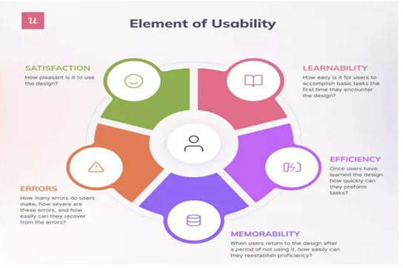
What are the elements of usability?

Slide 5
Elements of User Experience
The elements of the user experience are dependent on each other, and there are five of them. Each level builds on the level before it, and they start with an abstract level toward a concrete one (from bottom to top).

Slide 6
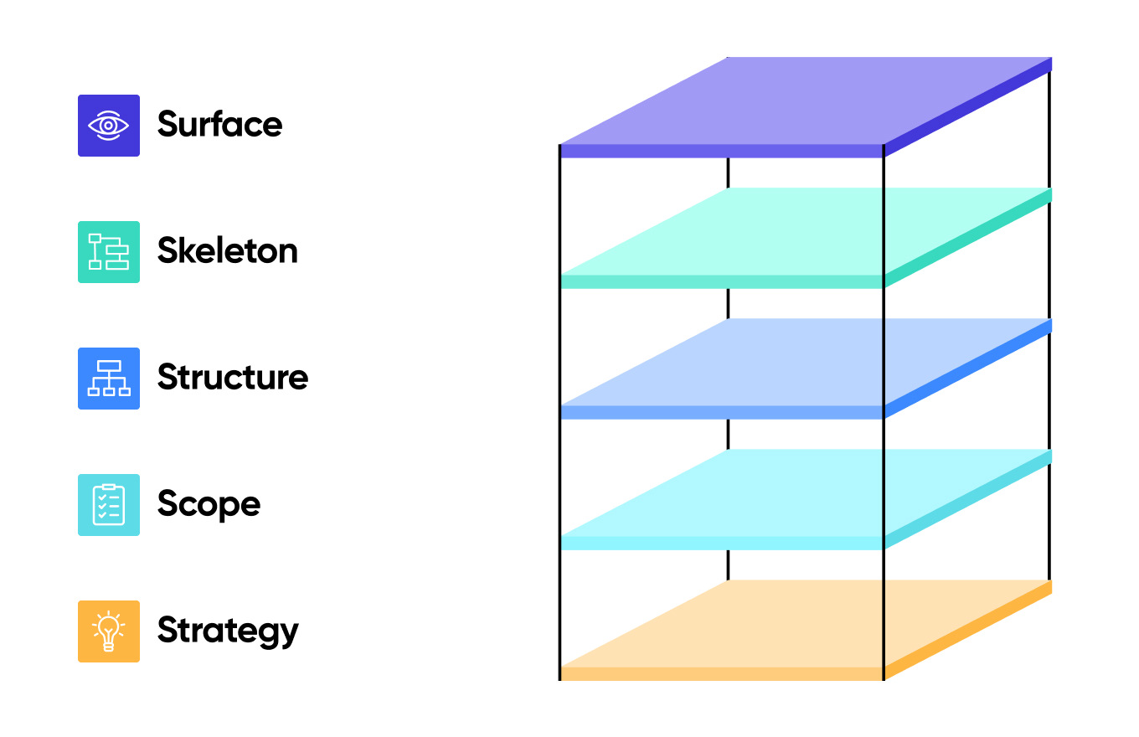
5 elements of User Experience

Slide 7
Difference between Usability and User Experience
Usability focuses on the ease of use, learnability and efficiency of the product.
In comparison, user experience (UX) is a broader concept – looking at the entire process even before the user interacts with the product.
In UX the focus is more on the user’s perception of how the product or the site interacts.
Good user experience is created by managing the end-to-end user journey experience, in a way that can arouse emotional resonance.

Slide 8
Relationship between Usability and UX
Good usability plays an important role in delivering a great user experience, but that is just a part of user experience.
User experience depends on the user’s attitude and emotions towards the product. This covers all aspects of branding, functionality, psychological expectation and how they feel from the start to the end of the interaction.
As UX is quite subjective, UX design is a continuous process that involves research, planning, designing (and redesigning) and testing the product at regular intervals.
User testing covers both usability and user experience goals
To provide the best user experience, UX designers need to take care of a few aspects while creating a user-centered design.

Slide 9
User Experience
UX or user experience is how a user interacts with and experiences a product, service, system, platform, or website. It includes the user’s perception of the utility, ease of use, efficiency, and every part of their interaction with your website. It can be anything from subtle transitions to your site to more interactive experiences such as forms and search bars. There are a number of elements that contribute to creating great UX like interface design, usability, and user research.

Slide 10
Key Factors of Good UX Design
Usefulness
Usability
Consistency
Security
Accessibility
Credibility
Personalization
Valuable

